Slide 1
Introduction to Machine Learning
What is Machine Learning?
Pros and Cons
Algorithms and Scenarios
How to Get Started?

Slide 2
Machine Learning Workflow
Training Dataset
X1 | X2 | X3 | X4 | Y
Machine Learning System (e.g., a model)
ML Algorithm
Prediction
X1 | X2 | X3 | X4 | Y
Test Dataset

Slide 3
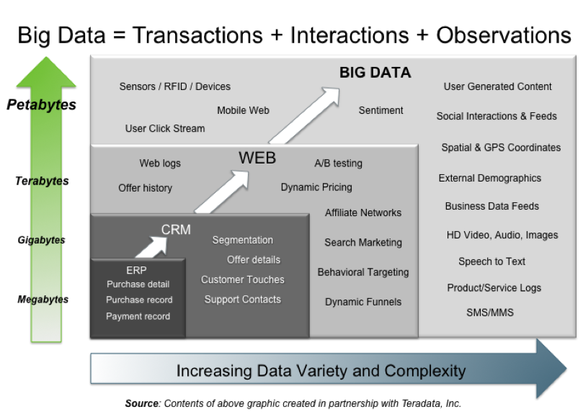
What is Machine Learning?
Machine Learning is a process of learning from Data
What can we learn from Big Data? How to extend KB?
Courtesy Dr. Jin, Kent State.

Slide 4

Machine Learning Models
Predicting a label
Predicting a number
Supervised Learning
Unsupervised Learning
Philosophical note: all learning problems fit into these general classes
Image provided by Scikit Learn

Slide 5
Recipe for Machine Learning
Training Data: Train the model
Test Data: Test the model performance
Accuracy?
Doesn’t work, train again
Test
Error
Think abouts?
Train
Can I use all data for training?
Best split for train and test dataset?
What is the goodness of a fit? And how do I measure it?
What if the fit is not good or acceptable?
Model Complexity

Slide 6
Terminology
Hyperparameters: Parameters that are used to control the learning process of a machine learning algorithm
Underfit: Simple fit that may lead to lower correction
Overfit: Complex fit that may lead to over correction
Feature Selection: aka hyperparameter
Outliers: point or group of points that don’t follow the trend
Curse of Dimensionality: Parameter-to-data proportionality or lack there of.

Slide 7
Machine Learning Algorithms
Machine Learning algorithms are applied to predict a class or label (classification) or a number (regression)
Polynomial Regression (relationship between dependent and independent variables)
Logistic Regression (categorical or label-based classifier)
K-Nearest Neighbor (distance-based classification)

Slide 8
Big Data →Data Science
Autonomous Cars → Self-driving capability
Electronic Records → Text mining, Speech Recognition
Stock (SKUs, manufacturing, etc.) → Business Intel.
Population → Precision Medicine, Cost of Care, etc.
Infrastructure → Smart * (*communities, cities, etc.)
So on..
Common Attributes
Big Data: Volume, Variety, Velocity (3Vs)
Features: Curse of Dimensionality
Feature Selection/Engineering: Machine Learning
Data types: numbers, audio/video, images, strings, etc.
What’s in It for ME?
Data Intelligence

Slide 9
Computing for Machine Learning
Rows – Instance (aka sample) of your data (SKU in supply chain, people in population, image in images, etc.)
Columns - features (observation or attribute) of your data (SKUs: how many SKUs, what type of SKUs, People: sex, disease, height)
Target - what you are trying to get your system to predict (business intel, cost of care, etc.)
M-by-N matrix
feature
Label/Target
a1,1
a1,2
…..
a1,n
Y1
Y2
Y3
.
.
sample
a2,1
a2,2
a2,n
am,1
am,1
am,n
.
.
.

Slide 10
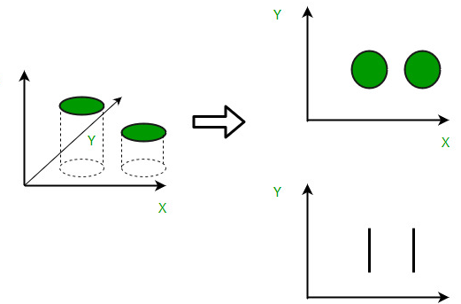
Data Intelligence
Pick good features (by hand)
Find more data (on chosen features)
Improve Data Intelligence
Extract meaningful relationships between data (sample → features)
Dimensionality reduction (can fewer features → same outcome)
Clustering (group related data)
Naïve (Bayes) clustering group the data based one feature
Better clustering group the data based on more features
Dimensionality Reduction

Slide 11
Classification Vs. Clustering
Classification
Clustering
Weight
Adults
Weight
Children
Height
Height
Classification groups targets of a prediction (aka label data): Examples include adult, child, types of infections, etc.
Clustering groups similar instances together (sample data): Examples include behaviors, types of infections specific to child or adult, etc.

Slide 12
Feature Engineering
Raw Data
Machine Learning Model
Feature engineering involves creating more or better features from raw data.
Assists in dimensionality reduction (e.g., Principal Component Analysis)
BMI is good enough to replace two features: height and weight.
New features may be a result of intuition, data knowledge, or research.

Slide 13

Machine Learning
Object
Feature Extraction
Classification
Output
Bird
Not Bird
Deep Learning
1
2
3
4
Bird
Not Bird
Deep Learning ➔ (“deep” = multilevel neural network)
Requires massive amounts of data and employs hidden variables (see network segments 2 and 3 above)

Slide 14
Recipe for Machine Learning
Step 1: Divide data into train and test datasets
Step 2: Feature Selection. Explore dimensionality reduction and feature engineering strategies
Step 3: Divide data into training and test sets
Step 4: Apply machine learning models classification (for label data), regression (for numerical data).
Step 5: Validate the model accuracies on test data
Step 6: If model accuracy is not acceptable go to STEP 3

